Slide 1
Task 1 : Explanation

Slide 2
1
Interface CharSequence
Let’s start with the first set of slides

Slide 3
public interface CharSequence
A CharSequence is a readable sequence of char values. This interface provides uniform, read-only access to many different kinds of char sequences. A char value represents a character in the Basic Multilingual Plane (BMP) or a surrogate

Slide 4
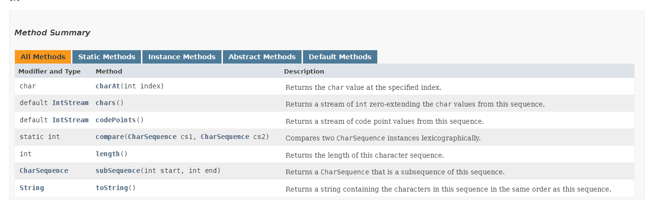
Method Summary
From :the attached sent link

Slide 5
Functions Types
The interface’s function are differ in their types as following in the next slide

Slide 6
Interface Functions Types
There are 4 types used here
Static | Instance | Abstract | Default
Defined as a member Of an Object but is accessible from API’s object constructor or from any instance created via Constructor of class in our interface is there is one : compare​(CharSequence cs1, CharSequence cs2) | Just require an Object of its class to be created before calling we have : charAt​(int index) -chars() -codePoints() -length() -subSequence​(int start, int end) -toString() | Does not require implementation of its deceleration We have : charAt​(int index) length() subSequence​(int start, int end) toString() | provide backward compatibility so that existing interfaces can use the lambda expressions without implementing the methods in the implementation class We have : codePoints() chars()

Slide 7
Here The mind map of the classification according to their accessibility
Charsequence
Interface
Static
Default
Instance
Abstract
compare​(CharSequence cs1, CharSequence cs2)
chars()
Chars()
subSequence​(nt start, int end)
charAt​(int index)
codePoints()
Codepoints()
toString()
Length()
length()
subSequence​(int start, int end)
charAt​(int index)
toString()

Slide 8

In the next pages The functions demonstration

Slide 9
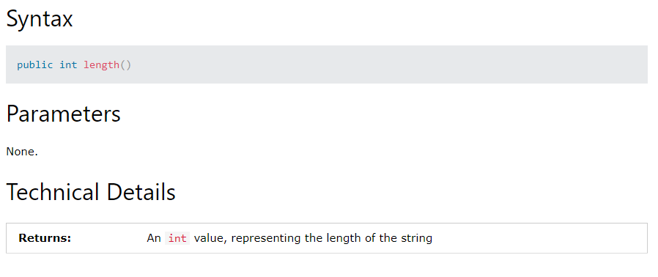
Length Method Returns the length of this character sequence. The length is the number of 16-bit chars in the sequence.

Slide 10
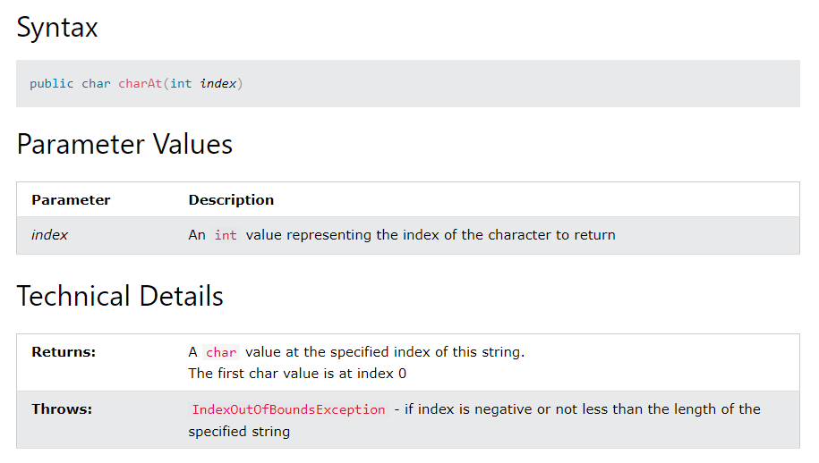
Char At Method
Returns the char value at the specified index. An index ranges from zero to length() - 1. The first char value of the sequence is at index zero, the next at index one, and so on, as for array indexing.

Slide 11
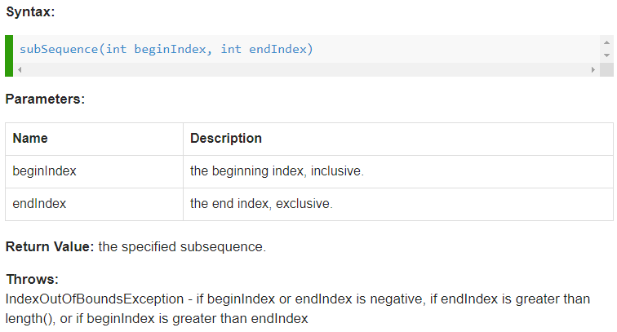
subsequence Method Returns a CharSequence that is a subsequence of this sequence. The subsequence starts with the char value at the specified index and ends with the char value at index end - 1. The length (in chars) of the returned sequence is end - start, so if start == end then an empty sequence is returned.

Slide 12
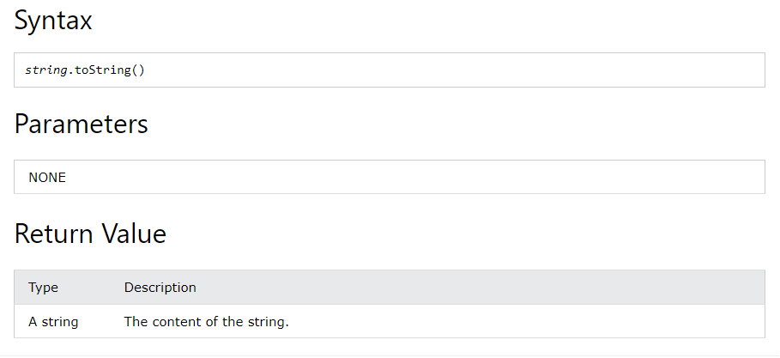
To String Method Returns a string containing the characters in this sequence in the same order as this sequence. The length of the string will be the length of this sequence.

Slide 13
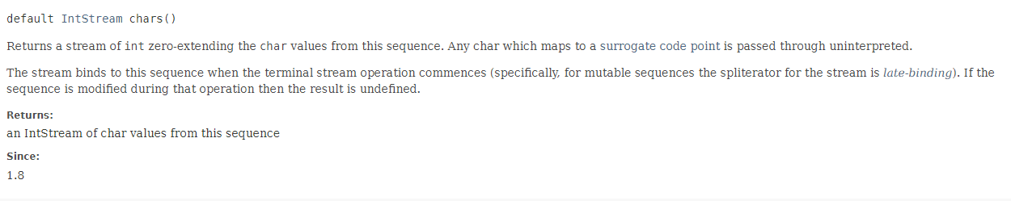
IntStream chars() Method
Returns a stream of int zero-extending the char values from this sequence. Any char which maps to a surrogate code point is passed through uninterpreted.

Slide 14
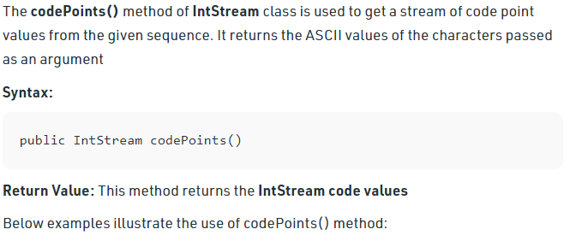
default IntStream codePoints() Method:
Returns a stream of code point values from this sequence. Any surrogate pairs encountered in the sequence are combined as if by Character.toCodePoint and the result is passed to the stream. Any other code units, including ordinary BMP characters, unpaired surrogates, and undefined code units, are zero-extended to int values which are then passed to the stream.

Slide 15
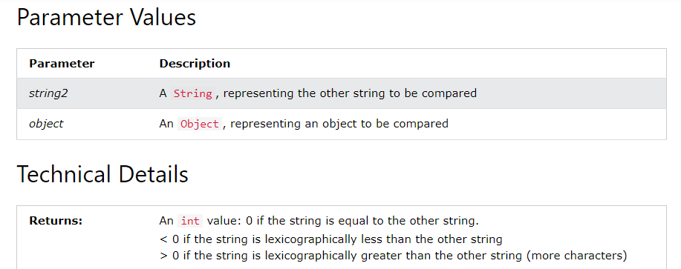
compare​ Method:
Compares two CharSequence instances lexicographically. Returns a negative value, zero, or a positive value if the first sequence is lexicographically less than, equal to, or greater than the second, respectively.

Slide 16
Sources
1- W3schools website
2-GeekforGeeks website
3-https://docs.oracle.com/
4- StackoverFlow website
5- Educative website

